Slide 1
Topic Model and
Natural Language Processing
Author:Guo Tianyi
Date:2017/1/4

Slide 2
Summary
Language and topic
Topic models
Non-probabilistic model and probabilistic model
The application of topic model
What I think

Slide 3
Language and topic
Language is the ability to acquire and use complex systems of communication, particularly the human ability to do so, and a language is any specific example of such a system.
An important usage: Communication
Communication is continuous, is about a center called topic.
Topic is a grouping of words that are likely to appear in the same context, a hidden structure that helps determine what words are likely to appear in a corpus.

Slide 4
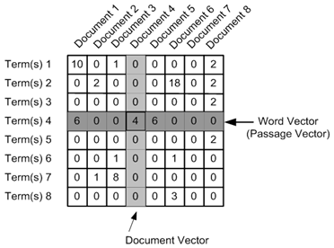
Topic models
Topic can be extracted from its feature words
TF-IDF
(Salton G; McGill, M. J. 1986)
$$tfidf\left(t,d,D\right)=tf\left(t,d\right)idf(d,D)$$

Slide 5
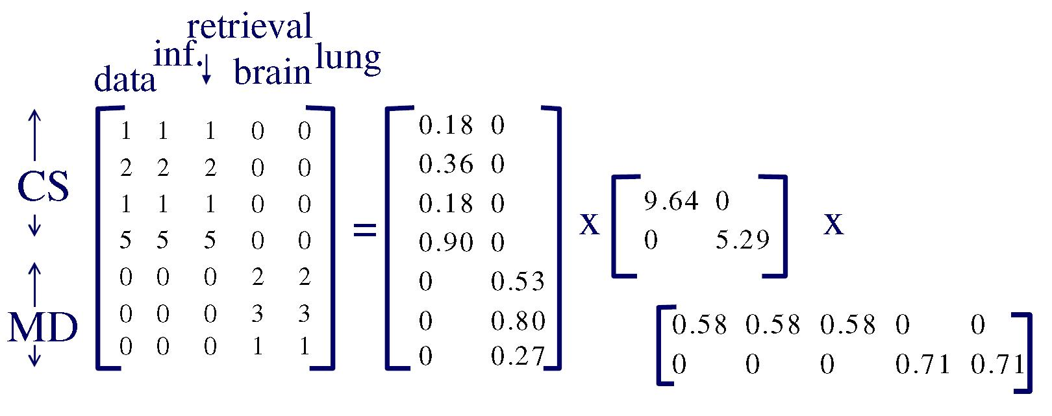
Topic models
Vector representation: LSI (Deerwester et al., 1990)

Slide 6
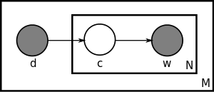

Topic models
Probabilistic: pLSI/pLSA (Hofmann ,1999)
$$p\left(d,w_{n}\right)=p(d)\sum_{c}{p\left(w_{n} | c\right)p(c|d)}$$
EM Algorithm

Slide 7
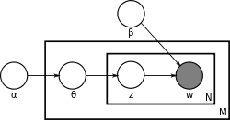

Topic models
Bayesian: LDA (Blei et al.,2003)
$$p\left(θ,z,w|α,β \right)=p(θ|α)\prod_{n=1}^{N}{p\left(z_{n} | θ\right)p(w_{n}|z_{n},β)}$$
Variational Inference/Gibbs Sampling

Slide 8
Non-probabilistic model and probabilistic model
Topic is a grouping of words that are likely to appear in the same context.
Each word is a base vector.
A topic can be represented as a liner combination of those base vectors.
Process a matrix to get topics

Slide 9
Non-probabilistic model and probabilistic model
Topic is a hidden structure that helps determine what words are likely to appear in a corpus.
Each word is a sample from a distribution.
A topic can be represented as the distribution.
Evaluate the distribution to get topics

Slide 10
The application of topic model
Text classification.
Topic evolution.
Topic-based authoring.
…

Slide 11
What I think

